Slide 1


Opportunities to Grow Child Health Plus on Long Island
A Healthfirst & LaGuardia Community College Data Analytics Project

Slide 2



Introduction
The following data analyses were conducted to help the enterprise grow, which is a strategic imperative for Healthfirst. This project investigates how Healthfirst can grow Child Health Plus (CHP) enrollment and market share in Long Island.
Research Questions: If Healthfirst launched a campaign to grow its CHP market share in Long Island among competitors, who should Healthfirst target? Additionally, when should the campaign launch?
Data Source (Child Health Plus Program Enrollment: Beginning 2009)
Data Provider: NYSDOH
Rows: 289K
Columns: 8
Updated: Last updated May 15, 2024

Slide 3
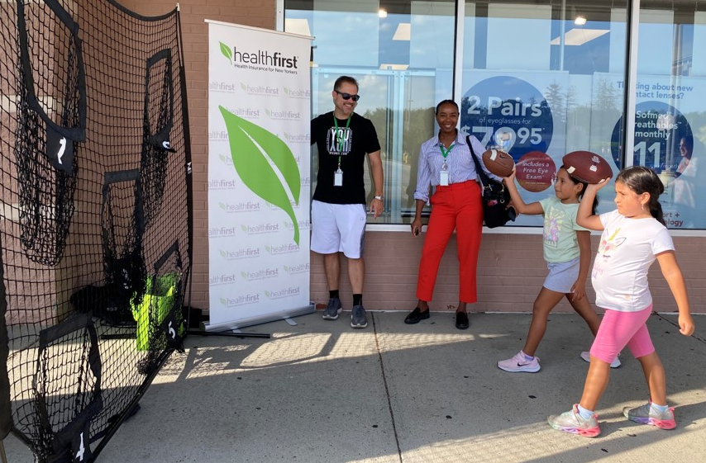

Methodology
Three data analyses were leveraged to answer research questions.
Jupiter Notebooks, Python, and Matplotlib were used.
Data was cleaned by renaming values to ensure consistency and accuracy.
To mitigate bias and ensure the integrity of the comparisons, data was:
Filtered by geographic location (Long Island).
Filtered by date (2017-April 2024).
The following visualizations were used:
Bar graphs to compare enrollment.
Line graphs to identify trends over time.

Slide 4

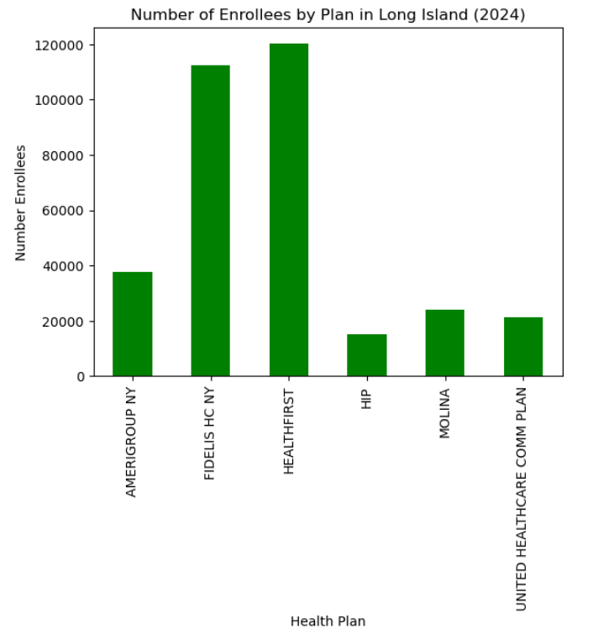
Healthfirst’s Sees Most Enrollment in Thus Far
36% Market Share
Healthfirst currently leads in Child Health Plus enrollments in Long Island in 2024.
Fidelis closely follows.
Objective: Grow CHP market share among competitors.
Notes:
Healthfirst market share 35%

Slide 5
Who should Healthfirst target?​

Slide 6
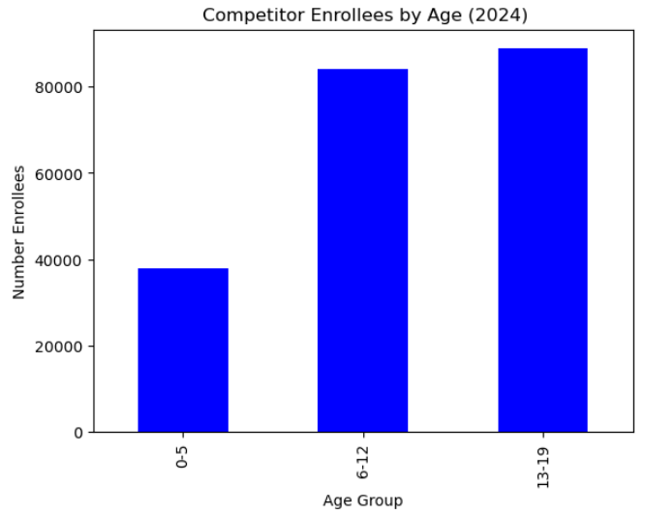
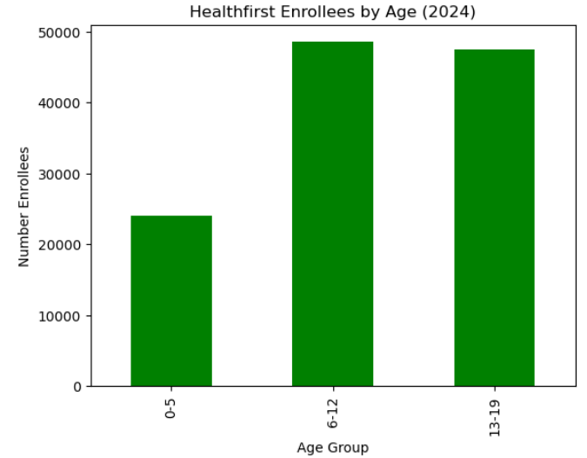

Most Growth Opportunity Comes From Parents of Teens
Teens between 13-19 years old make up majority of enrollments in the market and among competitors.
Healthfirst currently sees majority of enrollments from children/pre-teens 6-12 years old (second largest enrollment age group in the market).
Notes:
Teens and pre-teens

Slide 7
When should the campaign launch?

Slide 8
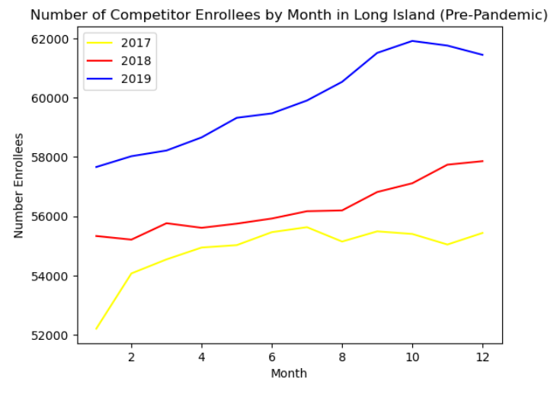
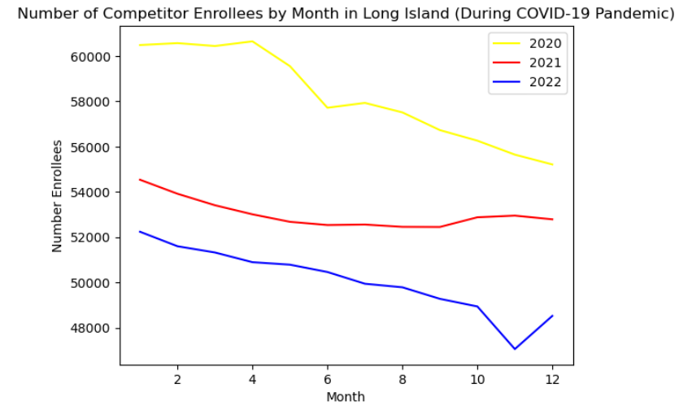
Enrollment Trends Shift Amidst a Global Pandemic
Competitors saw their most enrollment toward the second-half of the year before the COVID-19 pandemic (2017-2019). In contrast, competitors saw their most enrollment toward the first-half of the year during the pandemic (2020-2022).
2017-2019: Competitors saw higher enrollment as year progresses
2020-2022: Competitors saw less enrollment as year progresses

Slide 9
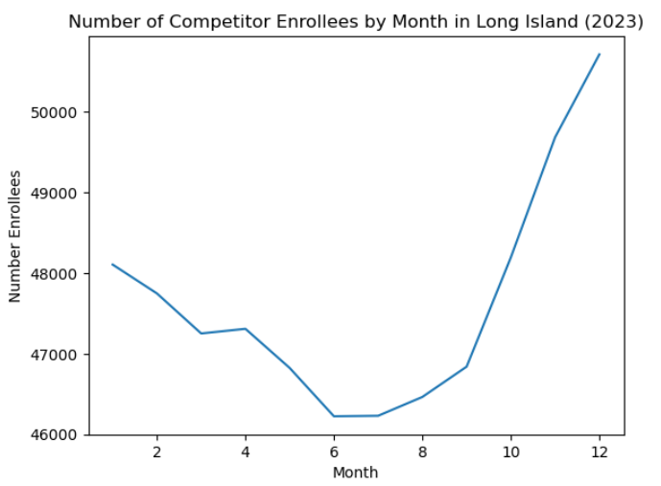
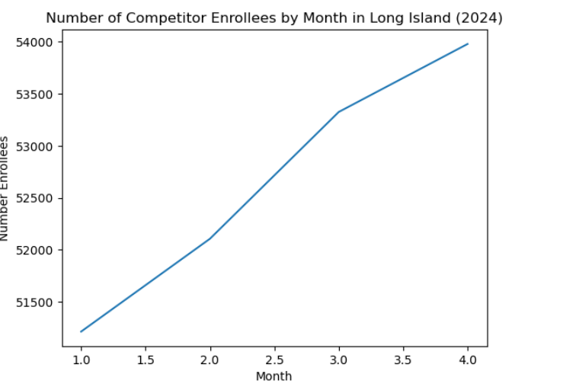
Enrollment Shifts Back to Pre-Pandemic Trends
As we emerge from the pandemic (2023 and 2024) we see competitors attain greater enrollment numbers toward the second-half of the year again.

Slide 10

Takeaways & Suggestions
Persuade Parents of Teens
1
Launch During the First-Half of the Year.
1
2
1
Prioritize targeting parents of teenagers (13-19) for a greater opportunity to increase market share.​
Parents of children/pre-teens (6-12) can be a viable secondary audience.
Healthfirst should run its campaign in Q1 and/or Q2.
This helps influence the market before potential peaks in enrollment among competitors.
1
Call to Action
3
Keep your teenagers and pre-teenagers happy and healthy before summer break.

Slide 11
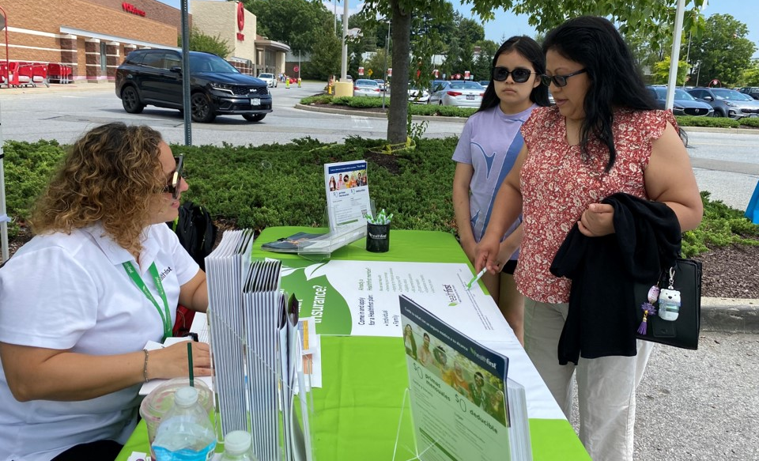
Next Steps...
Conduct additional research around target audiences in Long Island to identify:
Insurance needs and desires.
Strongest communication/marketing channels.
Develop messaging and creative content.
Establish a campaign timeline during Q1 and/or Q2 of 2025.

Slide 12
Questions?

